Slide 1


Unlock Your Future Success:
Explore Study Opportunities in Latvia

Slide 2
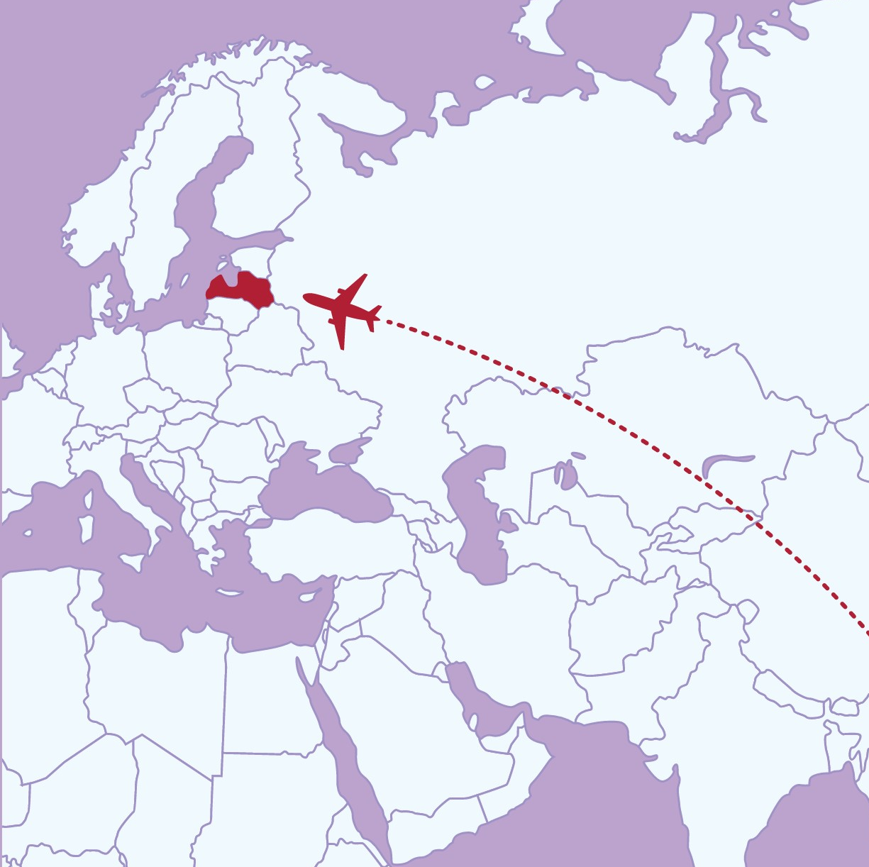
Latvia
Population 1,9 million
Currency EURO
Language – Latvian
EU, NATO, EEA
#1 most startup friendly country in the world

Slide 3
National initiative managed by the VIAA in partnership with the Ministry of Education and Science
National guide to higher education
Administrator of state scholarships for foreigners

Slide 4
Tailored Education

Slide 5

18 higher education institutions
200+ programmes in English
Recognised by the
quality label
Ministry of Education and Science
Ministry of Foreign Affairs
Ministry of Interior

Slide 6

International students
10 653 International students 14,6%
115 different nationalities, the top:
India
Uzbekistan
Sweden
Ukraine
Germany

Slide 7
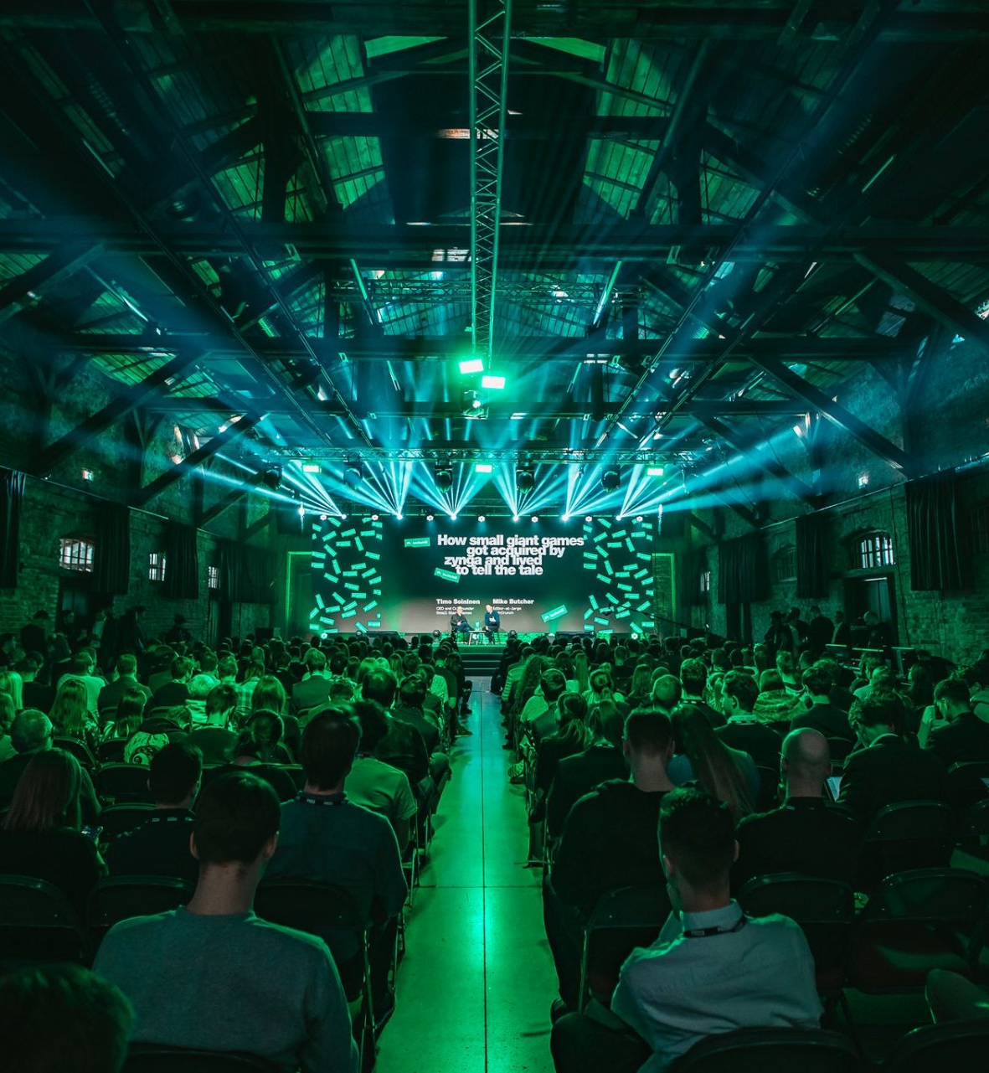

Buzz
Peace & Quiet

Slide 8
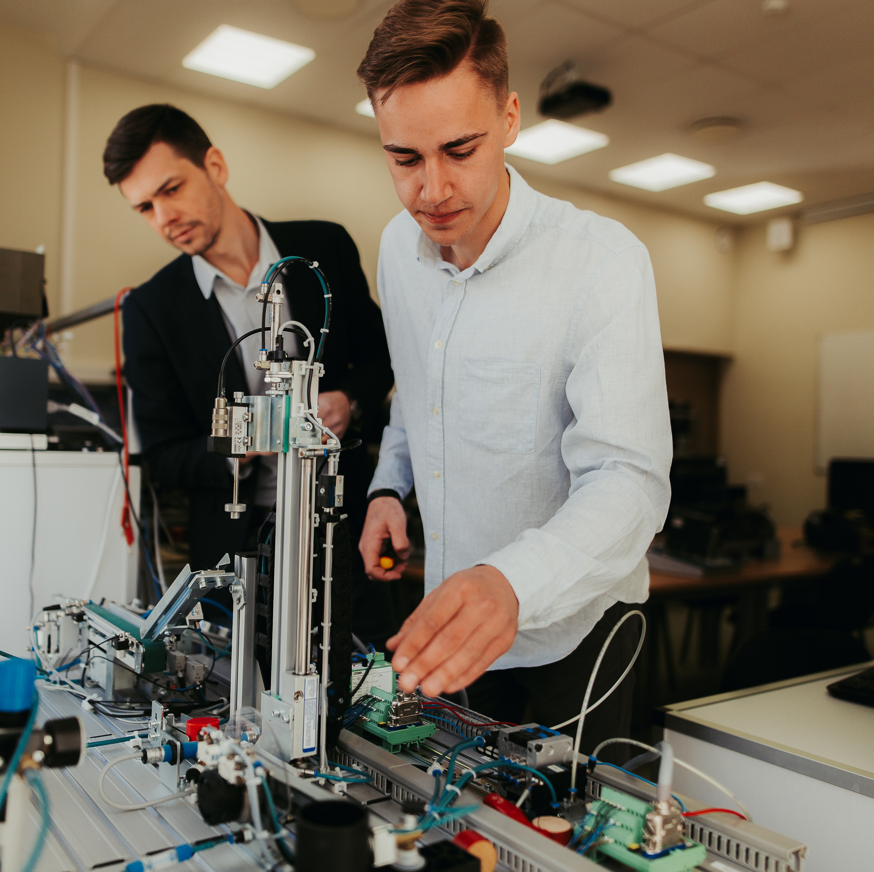
Personalised approach
Individual consultations with professors
University and industry partnerships

Slide 9

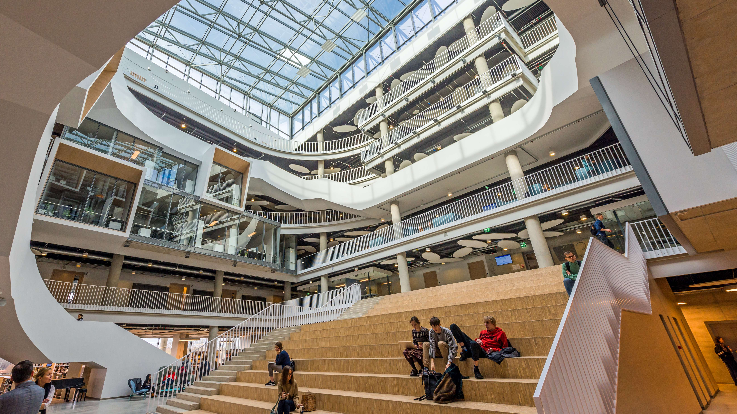
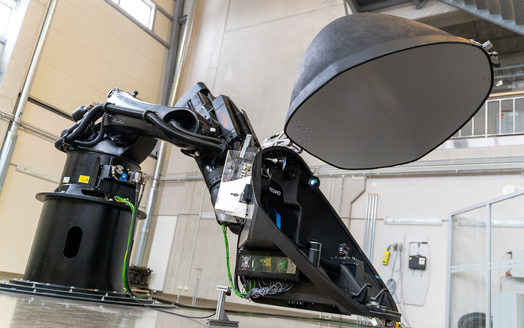
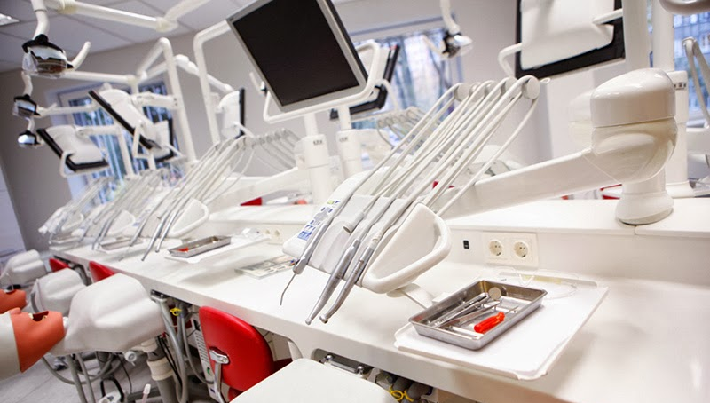
Modern facilities

Slide 10
Admissions 2x a year
Autumn admissions
(September intake)
Application deadline – around the beginning of June
Winter admissions
(February intake)
Application deadline –beginning of November to mid-October

Slide 11
Unlock Your Career Potential

Slide 12
Work while studying
Bachelor
20h per week
Masters & PhD
40 h per week
Career consultations available!

Slide 13

Erasmus+
Study mobility 3-12 months
Traineeship mobility 2-12 months
Recent graduate mobility 2-12 months
Combine various mobility activities for up to 12 months per study cycle!

Slide 14

After graduation
Extend your residence permit:
Bachelor – by 4 months
Masters and PhD – by 4-9 months

Slide 15
Work after graduation
Information & communication
Professional, scientific & technical
Accommodation and food service
Transportation & storage
Health & social work
40% of international graduates stay to work in Latvia
+10 000 ICT specialists
+6 000 STEM graduates
Average salary € 1 549 per month (€ 2 512 ICT per month)

Slide 16
Navigating Finances & Practicalities

Slide 17
Tuition fees
Healthcare €8,000 - €15,000
Business Administration
€2,000 - €6,000
Computer sciences
€2,000 - €4,000
Engineering
€2,700 – €4,000

Slide 18
Living costs
Accommodation
€85 – €400
Public transport
€12 – €30
Food
€200 – €300
Leisure & Entertainment
€7 – €50
Health insurance
€50
Average monthly living expenses
€700 – €800

Slide 19

Scholarships
For studies & summer schools
For nationals of 30+ countries
Annual call for applications: February 1 to April 1

Slide 20
Study Scholarships
Bachelor
€500 / month
Masters & 4th year professional
€600 / month
PhD
€700 / month
up to 10 months for Bachelor's and Master's
up to 11 months for PhD

Slide 21




Find & contact us
studyinlatviaLV
Studyinlatvia
@StudyLatvia
studyinlatvia@
viaa.gov.lv

